Slide 1
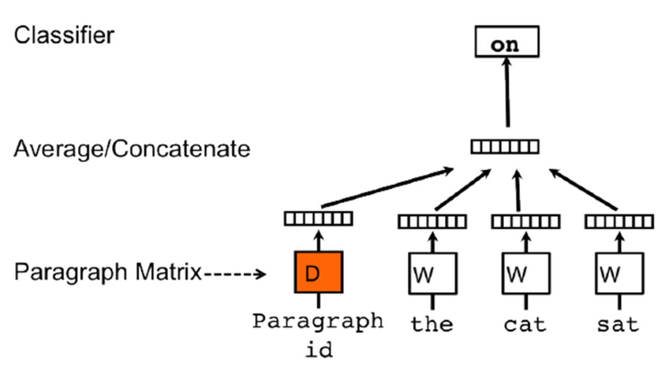
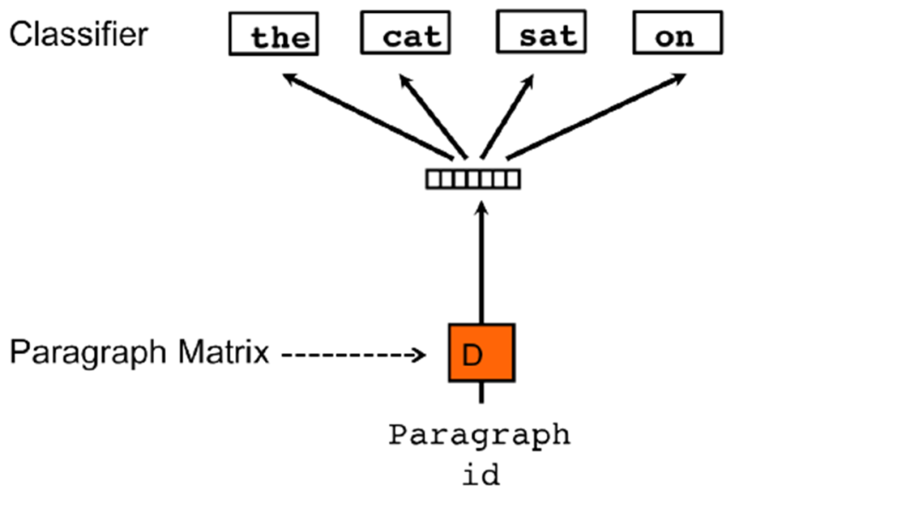
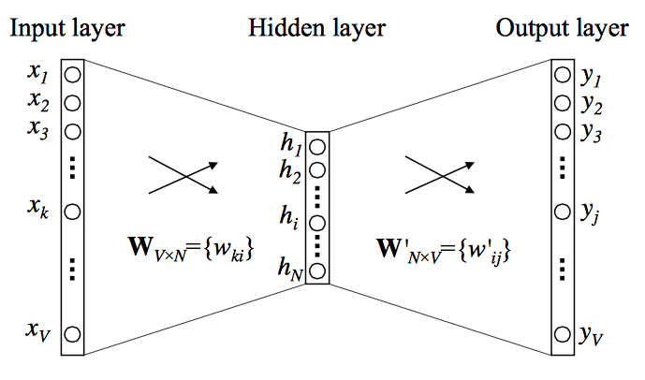
Semantic Textual Similarity: A Unified Framework for Semantic Processing and Evaluation
Milton King, Waseem Gharbieh, Sohyun Park, and Paul Cook
Semantic Textual Similarity
Paragraph Vectors: An extension of word2vec to text of arbitrary length. The Distributed Memory Model of Paragraph Vectors (PV-DM) was used to represent each sentence as a vector.
Given two sentences, determine their semantic similarity.
Similarity is a score from 0 to 5.
0: no similarity. For example:
- The farther away, the faster the galaxies move away from us
- Here is my answer to a similar question posted on the physics stack exchange website
5: equivalent. For example:
- BlackBerry loses US$965m in Q2
- BlackBerry loses $965M in 2nd quarter
Performance: Pearson correlation with human judgements.
Experimental Setup
Baseline Approaches
Sentence similarity is the cosine of their vector representations.
Evaluated on SemEval 2016 STS datasets.
5 text types; 9183 sentence pairs total.
Baseline Binary: The vectors hold binary values indicating whether the corresponding word occurs in the sentence.
Baseline Frequency: The vectors hold the frequency of the corresponding word in the sentence.
Tf-idf: Each vector holds the tf-idf weight for the corresponding word in the sentence. The aim of tf-idf is to de-emphasize frequent words by giving more weight to less frequent ones.
Results
Method | Answer-answer | Headlines | Plagiarism | Post-editing | Question-question | All
Baseline Binary | 0.50937 | 0.70636 | 0.80108 | 0.76370 | 0.61827 | 0.67881
Baseline Frequency | 0.44204 | 0.72754 | 0.79604 | 0.79483 | 0.65749 | 0.68122
Tf-idf | 0.45928 | 0.66593 | 0.75778 | 0.77204 | 0.61710 | 0.65271
Word2vec-Prod | 0.39310 | 0.60667 | 0.71528 | 0.21306 | 0.10847 | 0.41322
Word2vec-Sum | 0.13521 | 0.14328 | 0.23290 | -0.02673 | 0.25153 | 0.14303
Paragraph-vectors | 0.41123 | 0.69169 | 0.60488 | 0.75547 | -0.02245 | 0.50206
Skip-thoughts | 0.27148 | 0.23199 | 0.49643 | 0.48636 | 0.17749 | 0.33446
Skip-thoughts-Reg | 0.28626 | 0.51019 | 0.66708 | 0.69947 | 0.40459 | 0.51299
Average | 0.58520 | 0.69006 | 0.78923 | 0.82540 | 0.58605 | 0.69635
Regression | 0.55254 | 0.71353 | 0.79769 | 0.81291 | 0.62037 | 0.69940
Vector Embeddings
Word2vec: Each sentence is represented as the element-wise summation, and product, of the word embedding vectors for the words in that sentence.
Skip-thoughts: An encoder-decoder model composed of gated recurrent units used for sequence modeling.
Conclusions
None of the vector embedding approaches improved over any of the baselines by itself.
Combining vector embedding approaches via averaging and regression achieved modest improvements over the baselines.

